Slide 1
Mathematical Reasoning
Shreyas M
B.Tech in ECE PES University Bangalore

Slide 2
Chapter Map
Section | Topic
1 | Introduction
2 | Mathematical Words and Phrases: Logical “AND” “OR” “NOT” Validation “Implies” “Implied by” “If and only if” “For every – There Exists”
3 | Operation on connected statements
4 | Axioms and Lemmas

Slide 3
1 Introduction
Just as important as it is to understand the concepts, so is it to understand the “Language of Mathematics.”
Given any mathematical scenario, it can be summarized to smaller parts called “Statement”. A statement is any entity which conveys a well defined scenario for which we know the validity.
Validity state is the Truth Value. The truth value of any mathematical statement is said to be binary i.e. it can be considered as either “true” or “false”
The two major components of a statement are
Object(s) 2. Condition
Typical representation of a statement is as follows
<Statement-name> : <Object1> -- <Condition> -- < Object2>

Slide 4
Example :
“Mathematics is fun.” is not a statement because it’s truth value can vary and is not well-defined.
“How is mathematics?” is also not a statement because it has no truth value attached.
“Sun rises in the west” is a statement with a well-defined truth value which is “False.”
Objects : Sun, West
Condition : “Rises in”
“Moon is a satellite” is a statement with a well-defined truth value which is “True.”
Object : Moon, Satellite
Condition : “Is”

Slide 5
2 Mathematical Words and Phrases
Just like any other language, Mathematical statements too have set of rules called “Semantics” to be followed to make a “Sensible” Statement. (The correctness of a statement and Semantics of a statement)
For example, “A>B” ; “C>D” are two statements with particular truth values depending on values of A,B,C and D. But, both the statements put together without following rules, creates ambiguity in the truth value of the combination of the two statements.
To keep a check on these semantics, there is a set of Mathematical Phrases and words which add sense to combination of two statements

Slide 6
a) Logical words
Logical words are those connecting words in a combination of statements which results in a statement with a truth value which is influenced by truth value of each of the elementary statement.
Three logical connecting words.
“AND” (aka Conjunction)
“OR” (aka Disjunction)
“NOT” (aka Complementation, Negation)
Let us consider two statements S1 : O1--C1--O2 and S2 : P1--C2--P2.

Slide 7
Negation (“NOT”)
A negation is naturally applied on the Condition and not on the objects. It is denoted by ~ (Tilde).
S3➔~S1 : O1-- ”NOT” C1 -- O2. (The resulting statement has a truth value opposite to the truth value of Given statement.)
Disjunction (“OR”)
For the resultant statement to be true ATLEAST one of the elementary statement must be true.
S4 ➔ S1 “OR” S2
Conjunction (“AND”)
If even one of the elementary statements is a false one, the whole resultant has truth value false.
S5 ➔ S1 “AND” S2

Slide 8
Truth Table : A truth table (aka Validity Table) is a table used to verify the dependency of validity state of complete statement on the validity state of each elementary statement . The validity table for the three logical connecting words are shown below.
Let F=False, T=True
S1 | S2 | S4➔S1 “OR” S2 | S5 ➔ S1 “AND” S2
F | F | F | F
F | T | T | F
T | F | T | F
T | T | T | T
S1 | S3➔~S1
F | T
T | F

Slide 9
b) Validation
In validation, irrespective of the state of the whole statement, the validity of one elementary state is fixed based on the sate of the other. Hence, these can be termed as either Cause-Effect pairs or Requirement-Result pairs
There are 4 major types of Validations
Implication (used to derive a statement with desired validity)
Inference (used to explain the validity of the statement)
Bi-conditional (Necessary and sufficient condition)
Exception (An argument or a challenge to the validity of the statement)

Slide 10
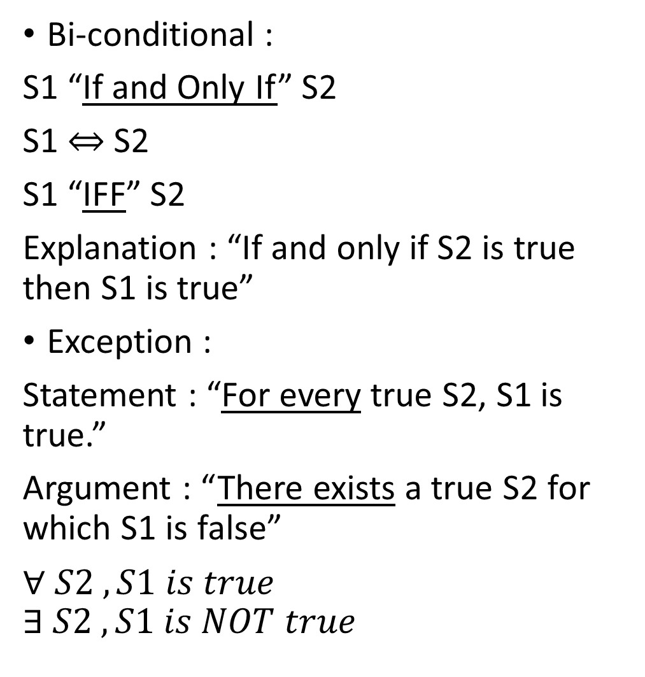
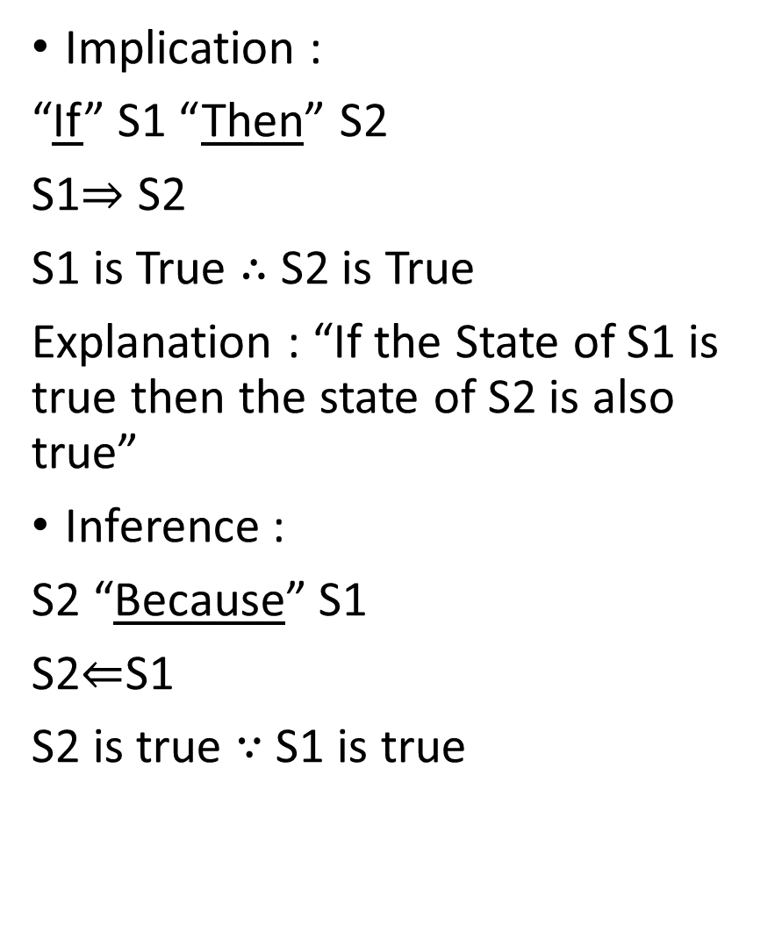
Implication :
“If” S1 “Then” S2
S1$⇒$ S2
S1 is True $∴$ S2 is True
Explanation : “If the State of S1 is true then the state of S2 is also true”
Inference :
S2 “Because” S1
S2$⇐$S1
S2 is true $∵$ S1 is true
Bi-conditional :
S1 “If and Only If” S2
S1 $⇔$ S2
S1 “IFF” S2
Explanation : “If and only if S2 is true then S1 is true”
Exception :
Statement : “For every true S2, S1 is true.”
Argument : “There exists a true S2 for which S1 is false”
$∀ S2 , S1 is true$
$$∃ S2 , S1 is NOT true$$

Slide 11
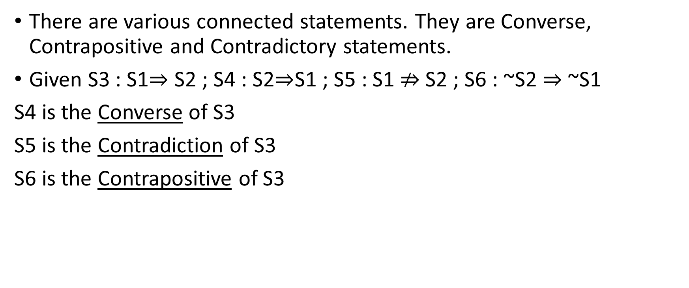
4 Operation on connected statements
There are various connected statements. They are Converse, Contrapositive and Contradictory statements.
Given S3 : S1$⇒$ S2 ; S4 : S2$⇒$S1 ; S5 : S1 $⇏$ S2 ; S6 : ~S2 $⇒$ ~S1
S4 is the Converse of S3
S5 is the Contradiction of S3
S6 is the Contrapositive of S3

Slide 12
5 Axioms and Lemmas
Axioms : Statements which are true but can be proved only in a
not-so-mathematical way.
Example : A>B “AND” B>C => A>C
Lemma : Statement which can be proved (or inferred) directly from a given true statement.
Example : Euclid’s Division Lemma
Let A,B,Q and R be the dividend, divisor, quotient and remainder
EDL ➔ A=BQ + R

Slide 13
Thank you
Shreyas M
B.Tech in ECE PES University Bangalore

